Slide 1
CUSTOMER ANALYTICS
Customer Performance
Dashboard
Source visuals and query results compiled into a single view
Prepared for Strategic Review • June 2026

Slide 2
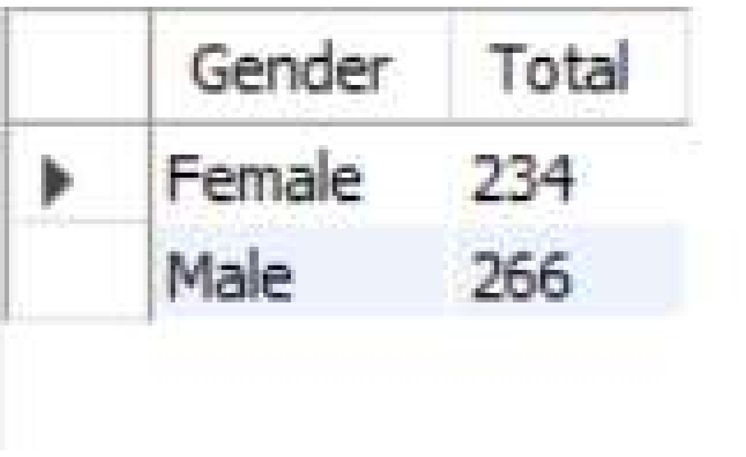
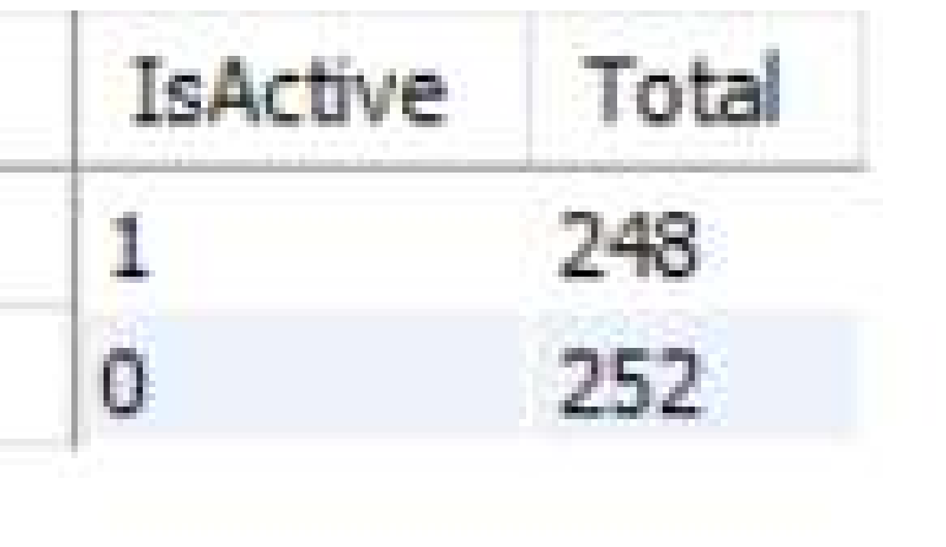
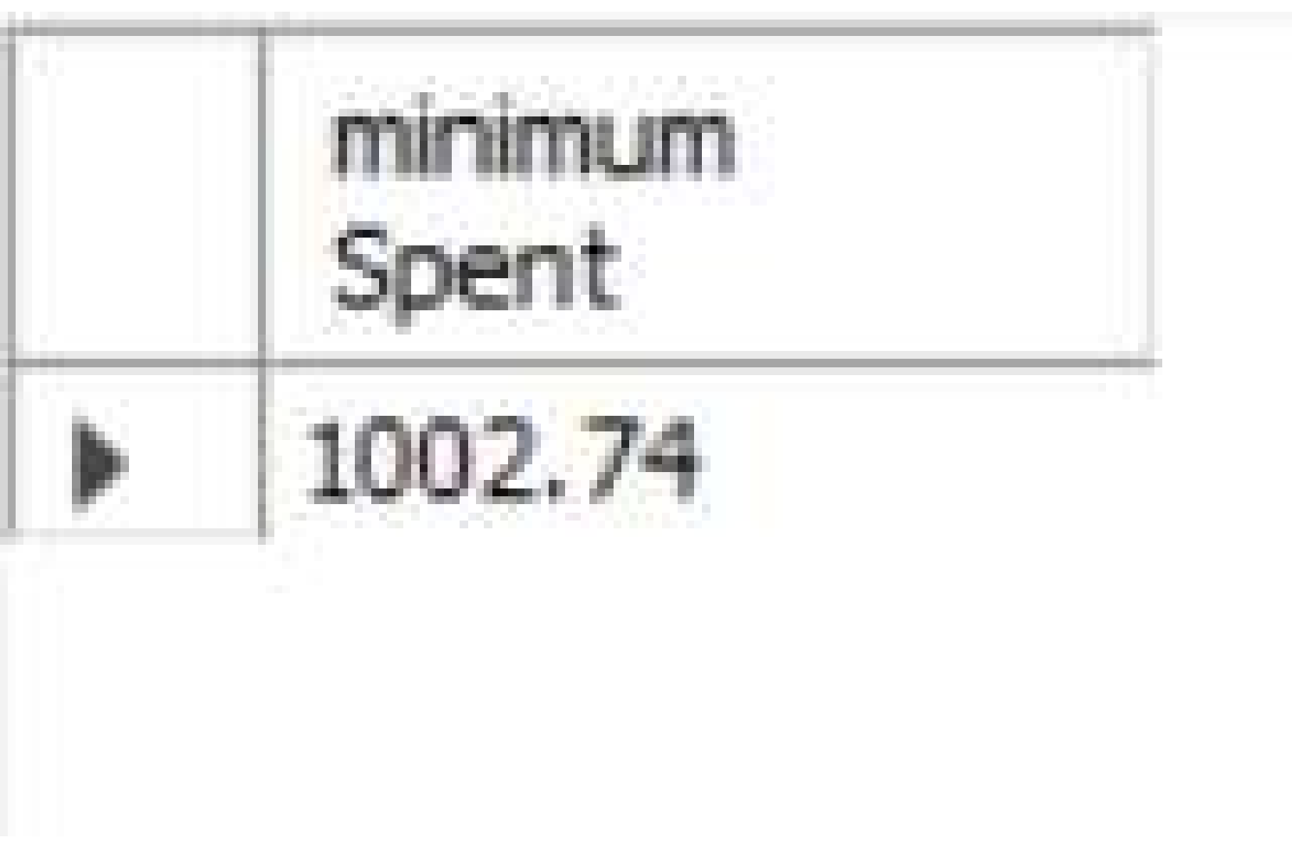
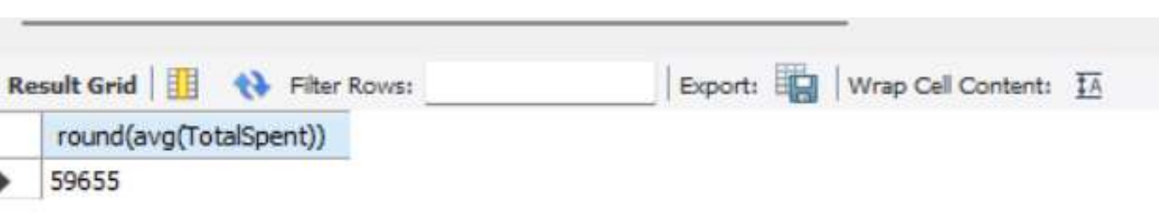
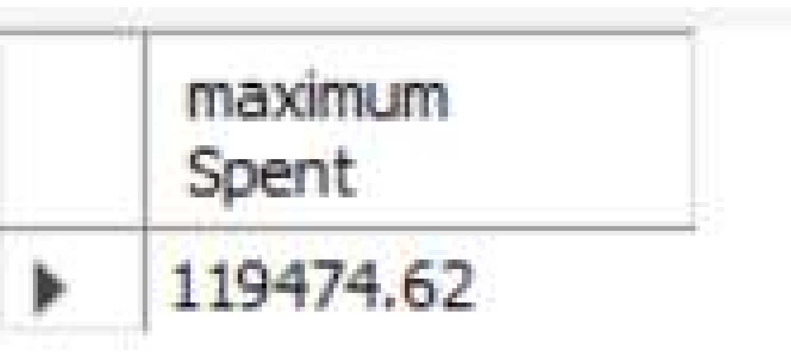
Key Performance Indicators
CUSTOMER ANALYTICS
Query result snapshots: customers, revenue, spending, and activity
TOTAL CUSTOMERS
TOTAL REVENUE
AVERAGE SPENDING
ACTIVE CUSTOMERS
500
₹2,98,27,605
₹59,655
248
Source: SQL query result grids (rounded average, maximum/minimum spend, gender totals, active-status totals)
Customer Performance Dashboard | Source: provided report
2

Slide 3
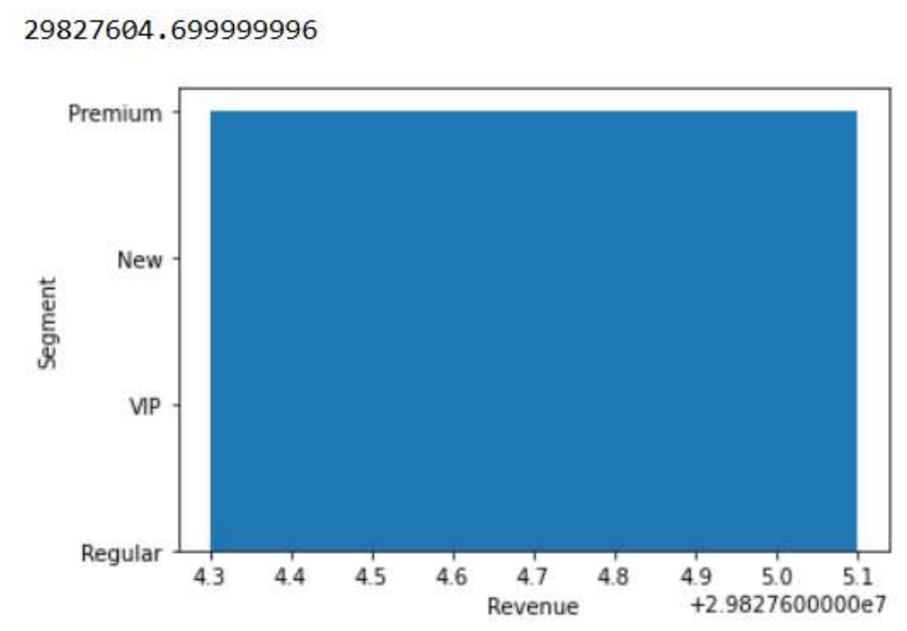
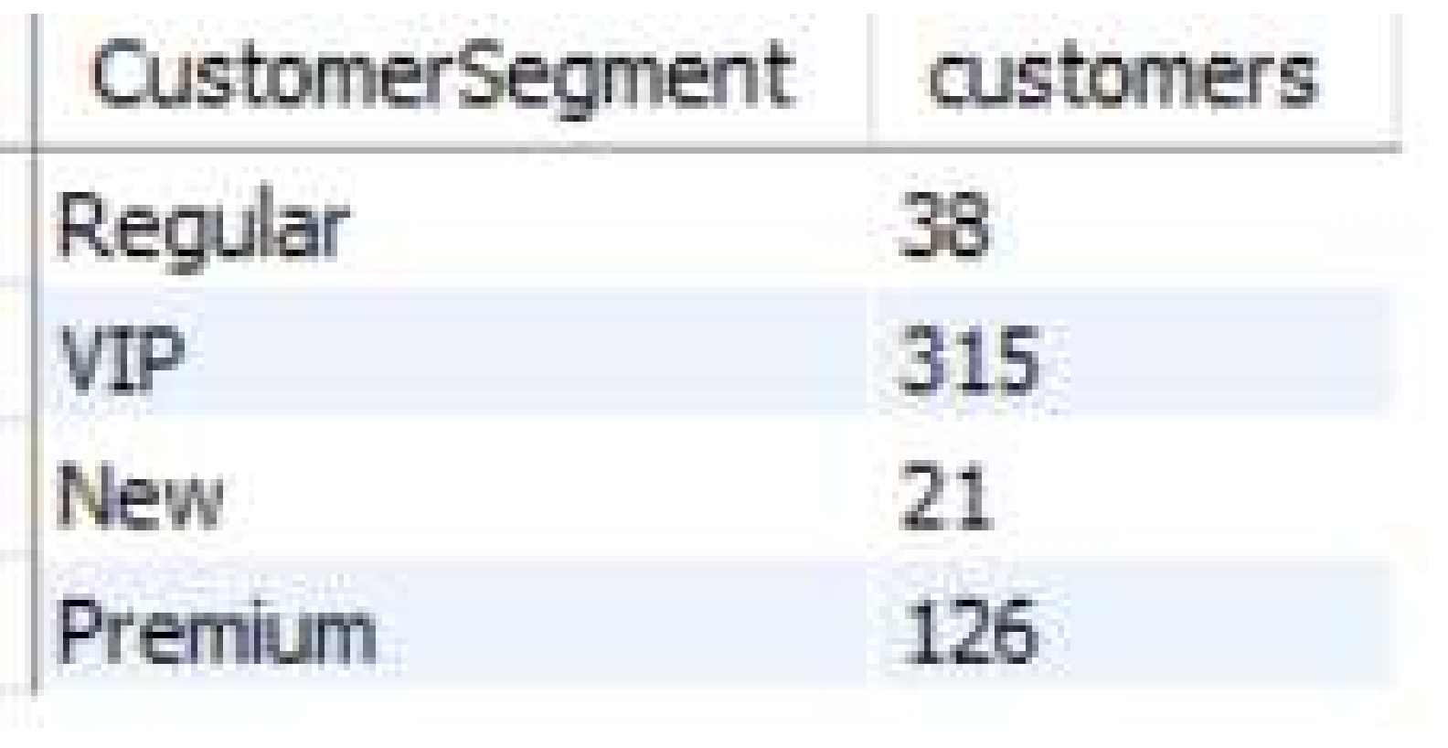
Customer Segments
CUSTOMER ANALYTICS
Segment-wise customer counts and revenue contribution, as queried
Customer Performance Dashboard | Source: provided report
3

Slide 4
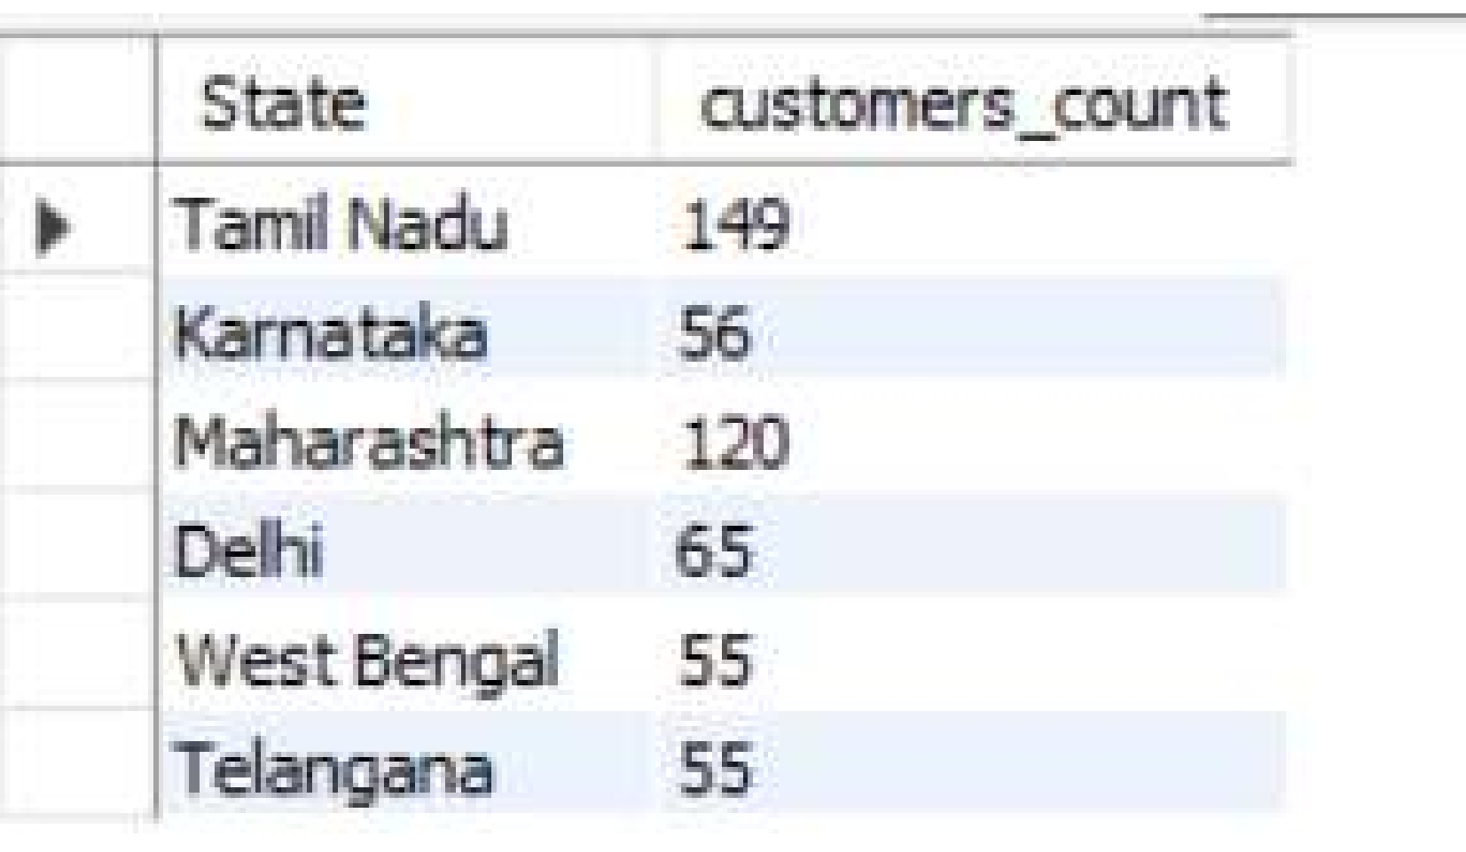
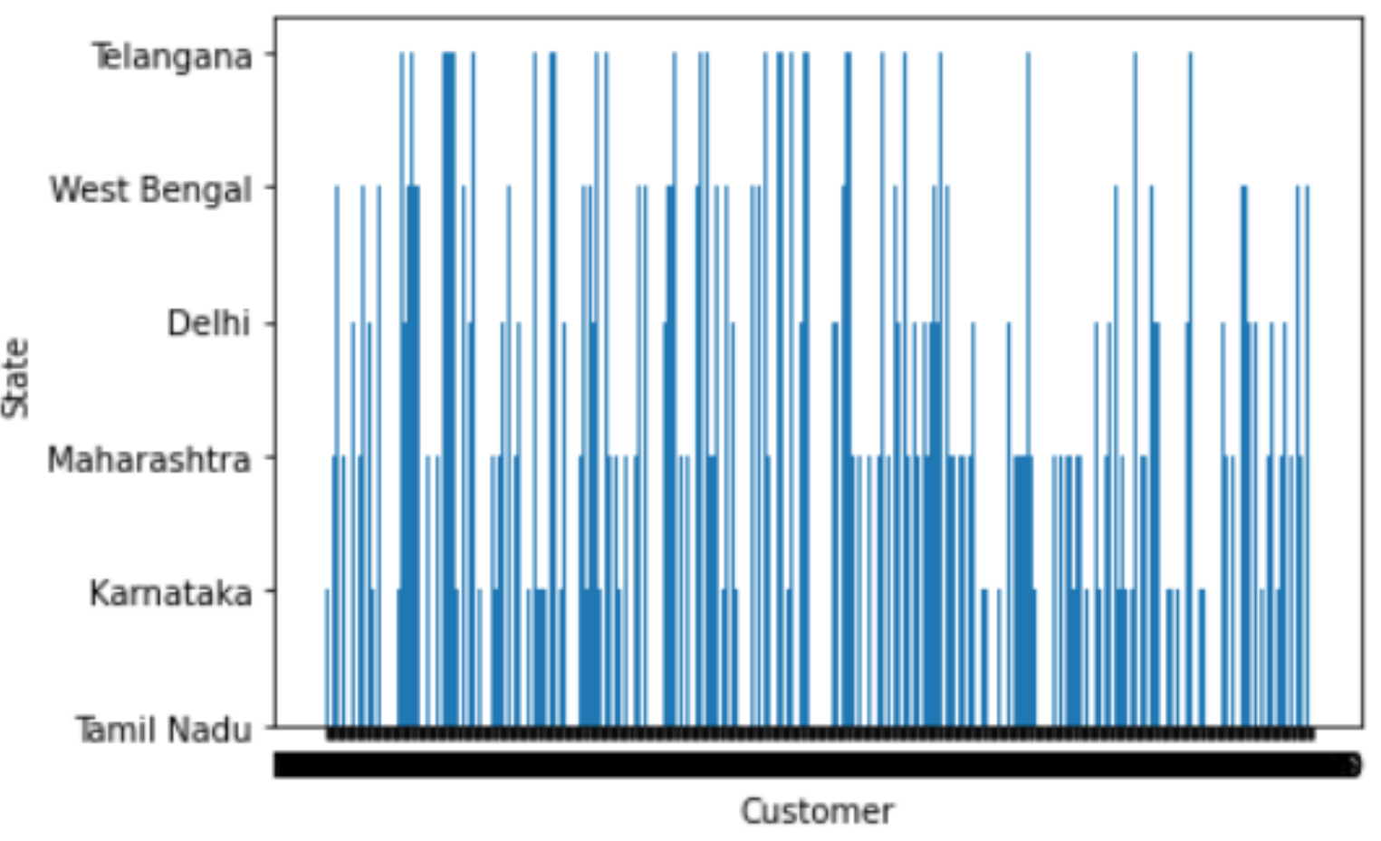
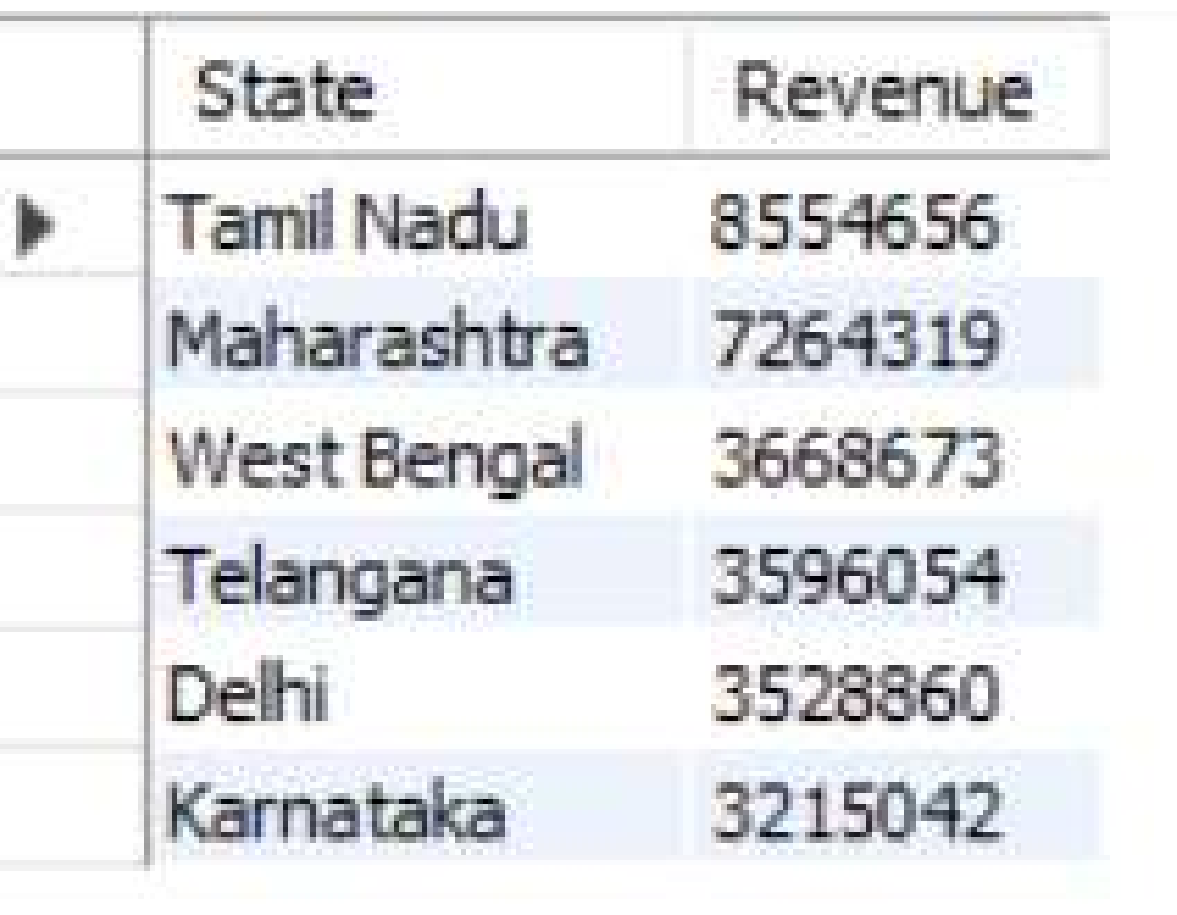
Geographic Distribution
CUSTOMER ANALYTICS
Customer counts and revenue by state, plus per-customer state markers
Customer Performance Dashboard | Source: provided report
4

Slide 5
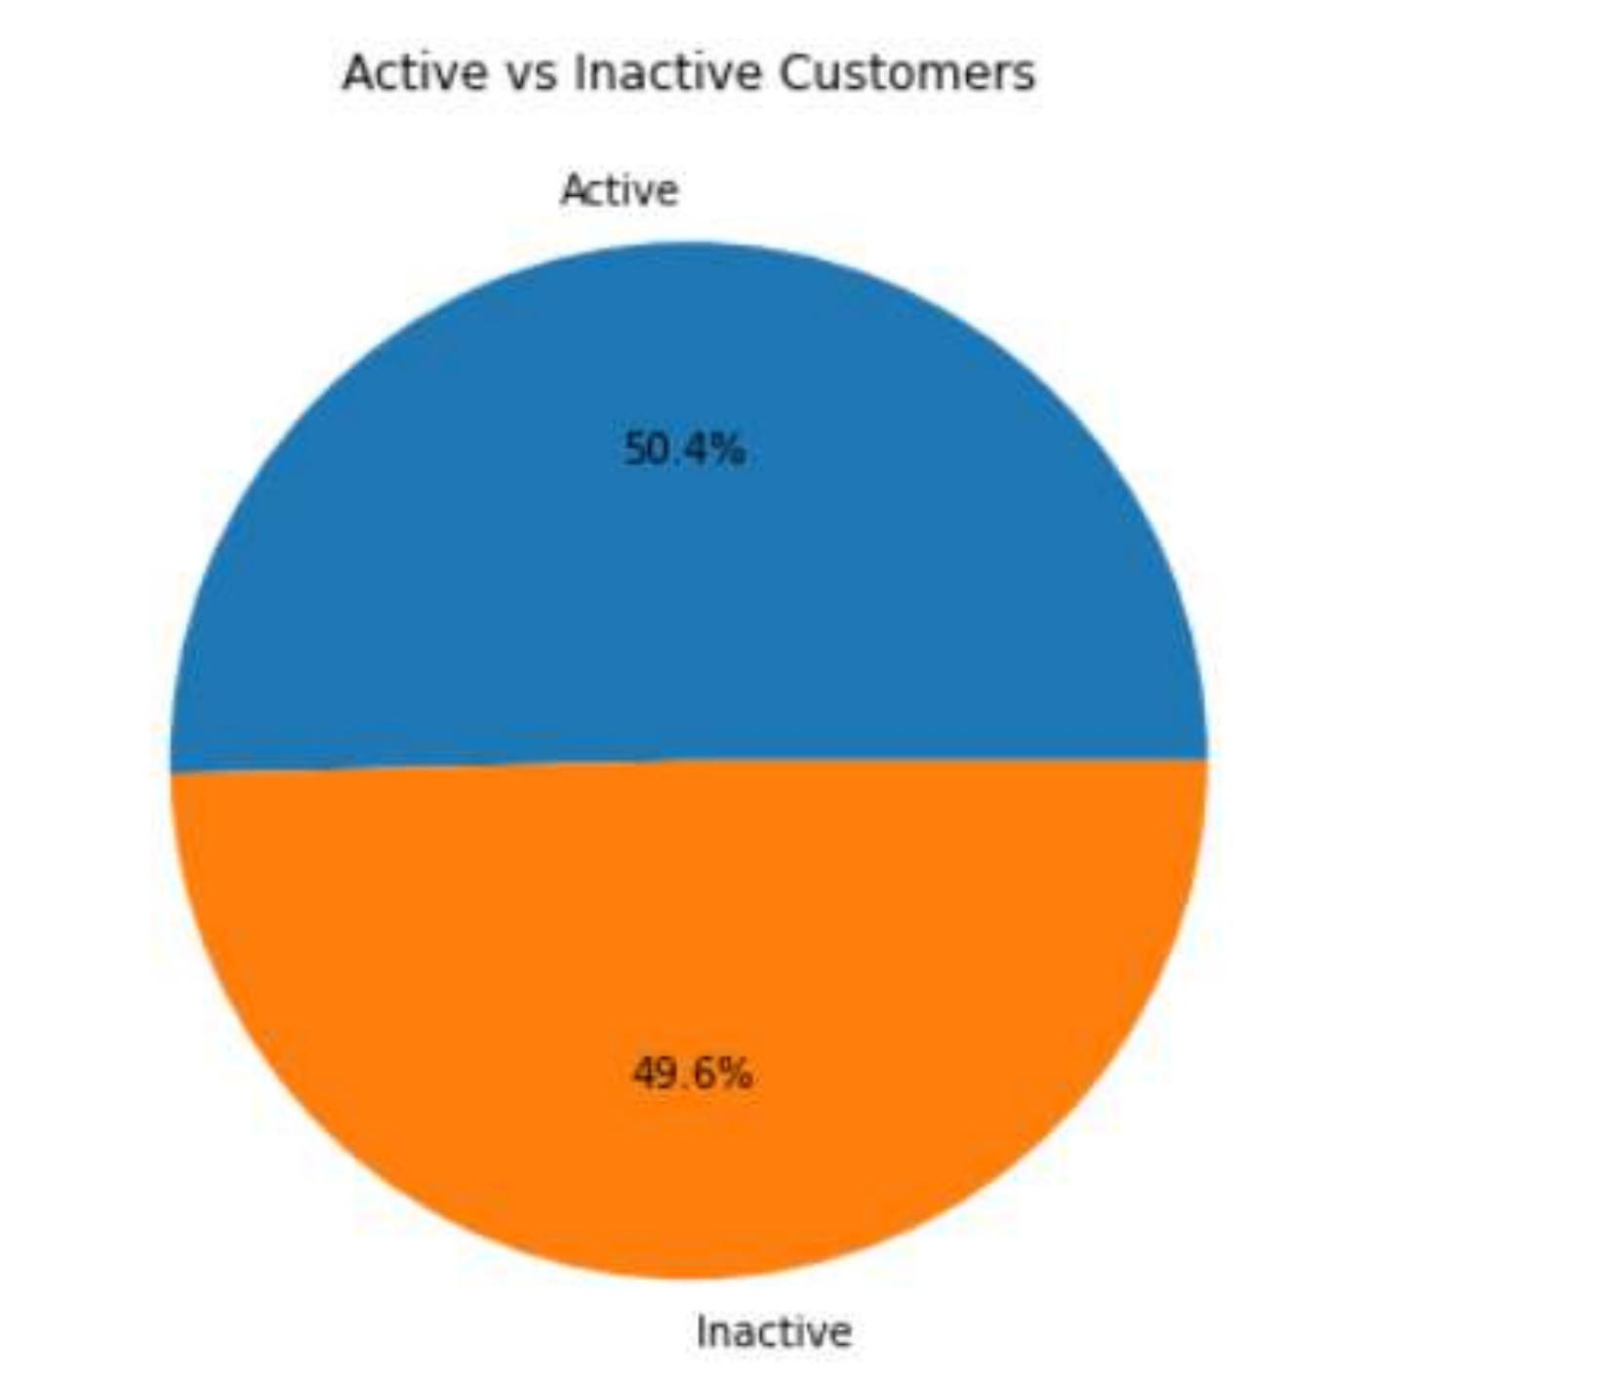
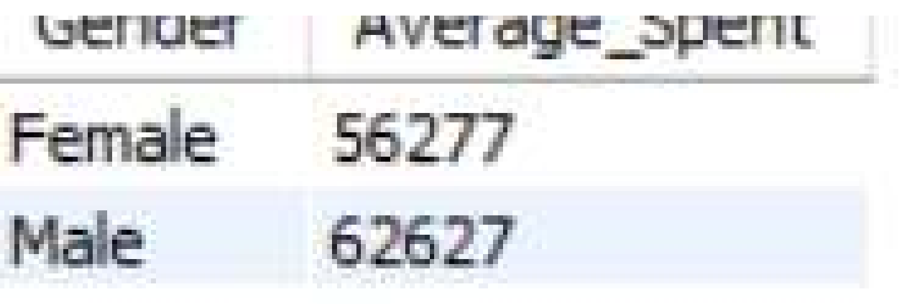
Customer Activity & Gender Mix
CUSTOMER ANALYTICS
Active vs inactive split, gender distribution, and average spend by gender
Customer Performance Dashboard | Source: provided report
5

Slide 6
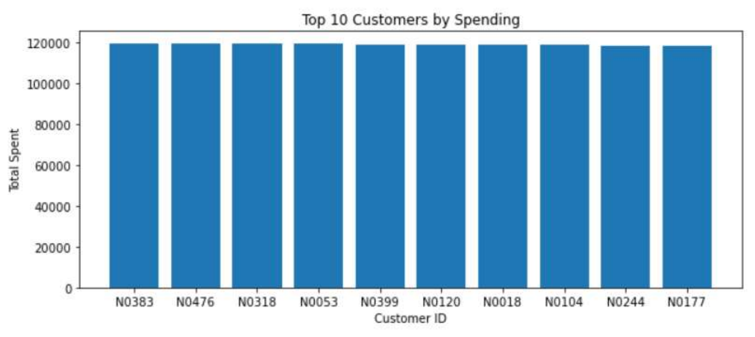
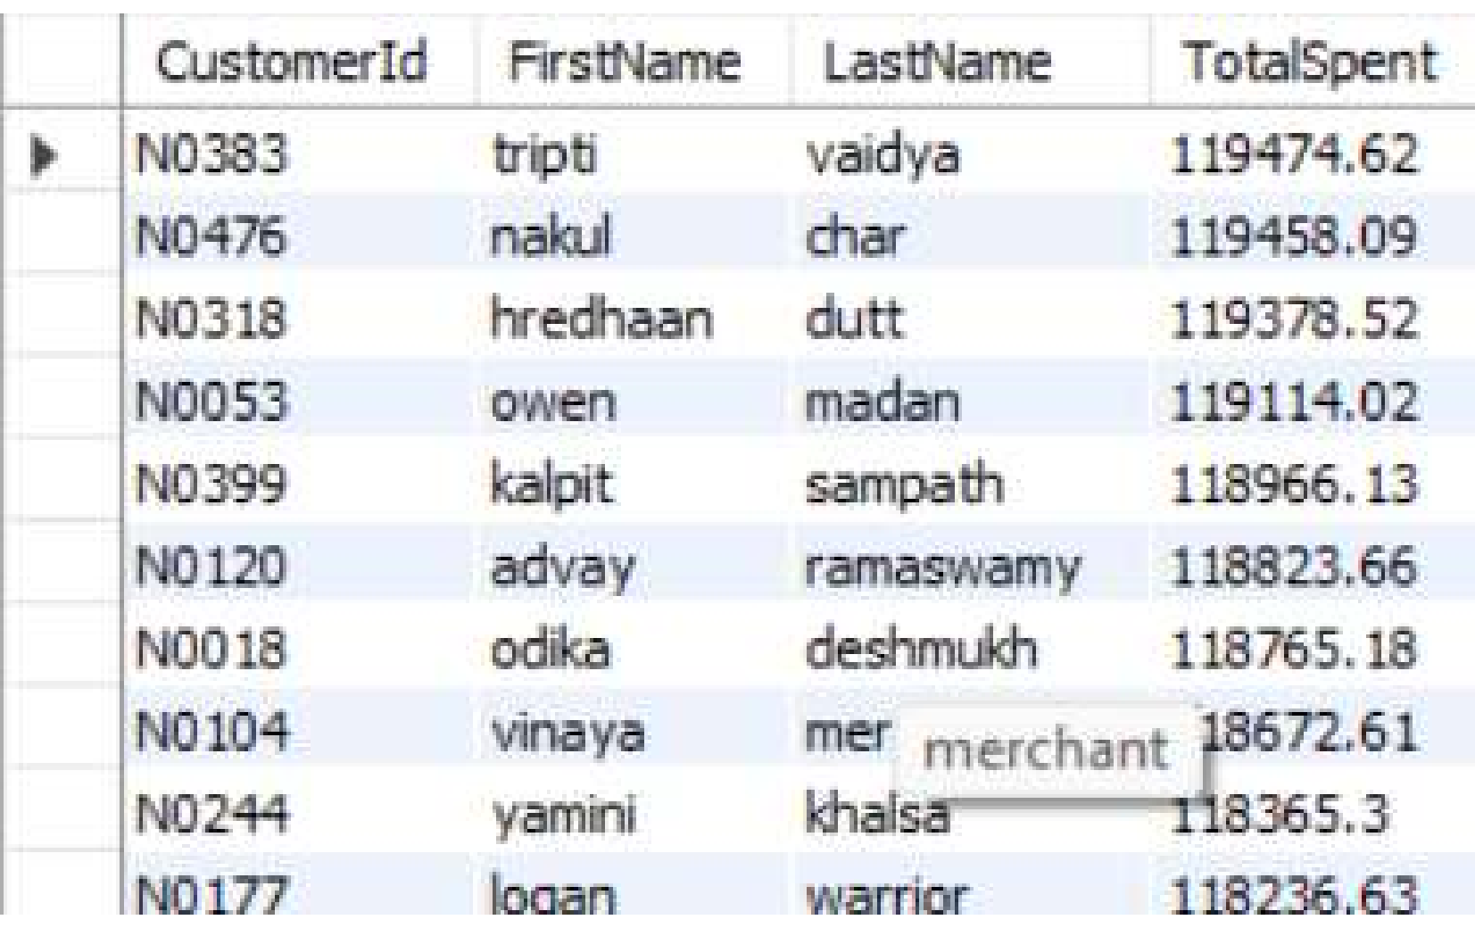
Top 10 Customers by Spending
CUSTOMER ANALYTICS
Highest-value customers, ranked by total spend
Customer Performance Dashboard | Source: provided report
6

Slide 7
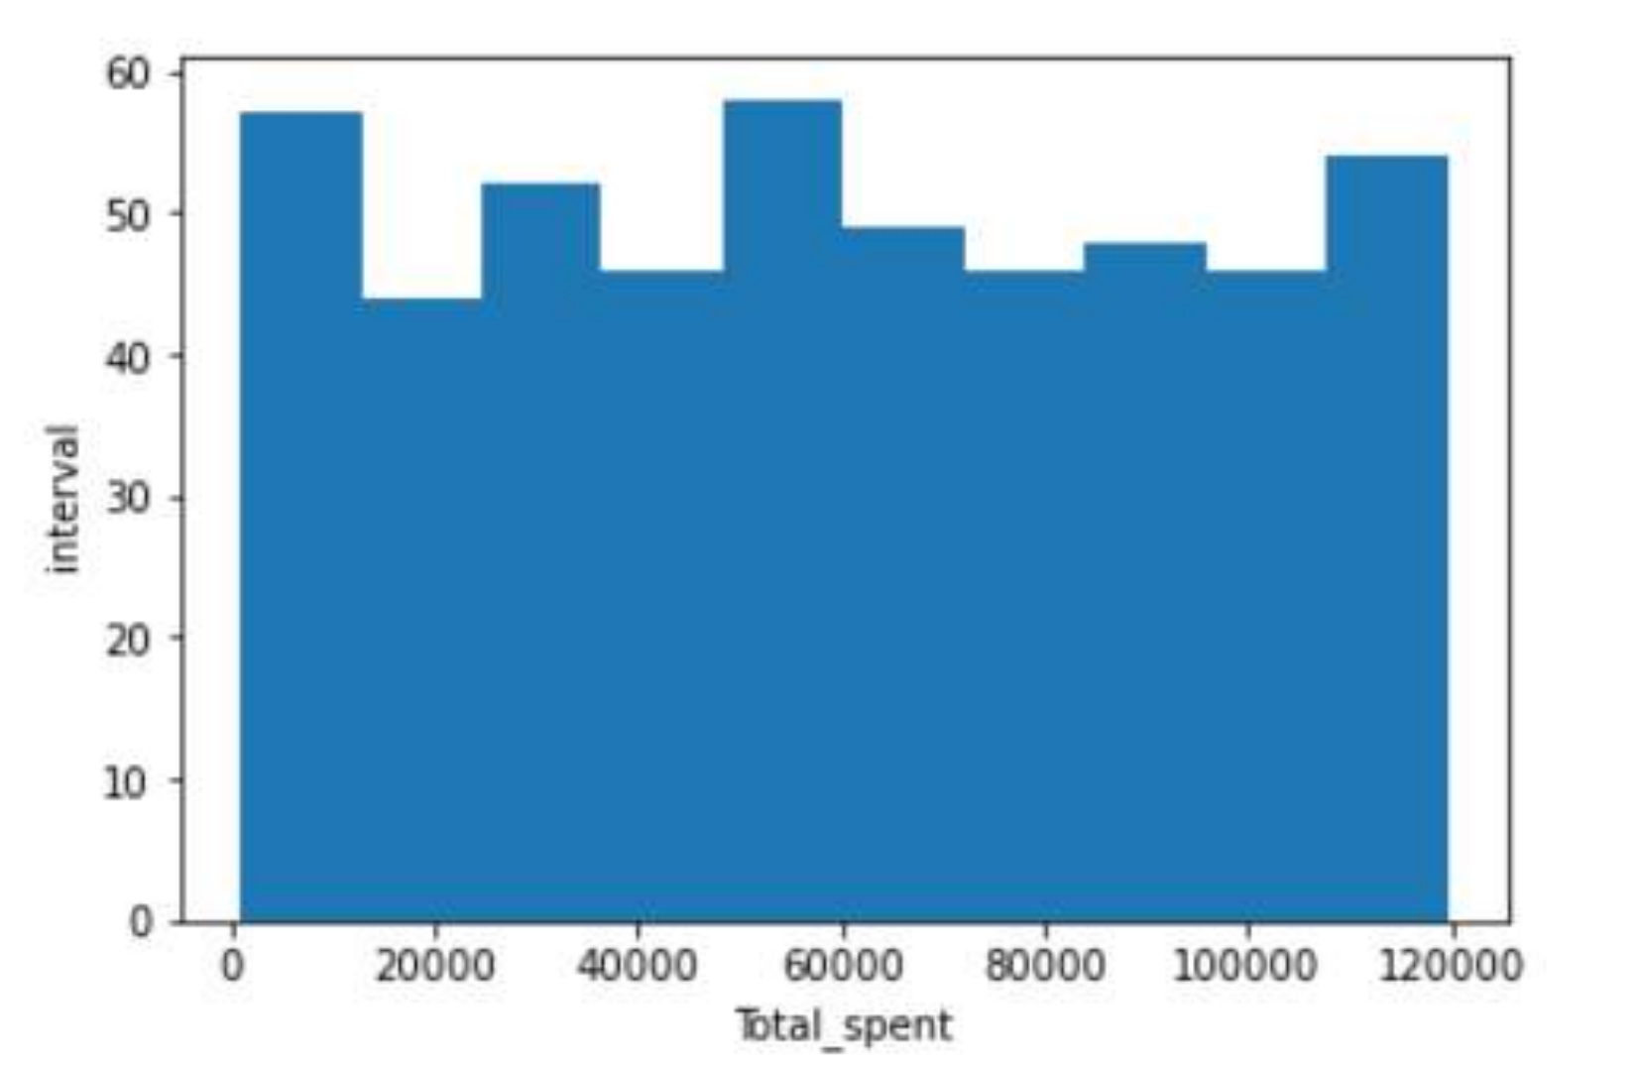
Spending Distribution
CUSTOMER ANALYTICS
Histogram of total spend across the customer base, with min/max reference
MAXIMUM SPENT
MINIMUM SPENT
Customer Performance Dashboard | Source: provided report
7

